Slide 1


Slide 2


J.S.S.S.D PAVAN KUMAR
II B.C.A – 1
K.B.N COLLEGE
Developer
Notes:
No slide master

Slide 3


A.ASHMITHA
DEVELOPER..
II Bsc – STAT
K.B.N COLLEGE

Slide 4


A.RIKHITHA
II Bsc – STAT
K.B.N COLLEGE
DESIGNER…

Slide 5


S.SATYA VINAY
TESTER..
II Bsc – STAT
K.B.N COLLEGE

Slide 6


P.PRAJAPATHI EXECUTOR II B.C.A – 1 K.B.N COLLEGE

Slide 7
Urban-Heat Islands Monitor
A Python-based GUI application

Slide 8
Problem
Urban heat islands (UHIs) are urban areas that experience significantly higher temperatures compared to surrounding rural areas. This phenomenon can negatively impact human health, air quality, and energy consumption. This application aims to address the need for a user-friendly tool to monitor and analyze UHI data.

Slide 9
Table of Contents
Abstract
Before starting our presentation
Introduction , Requirements , Modules
What I am saying ? what we need?
Potential Applications
For future
Future Work
Urban Sense
Ethical Considerations
Ethical Data Handling
Process
How it Works - Beat the City Heat!

Slide 10
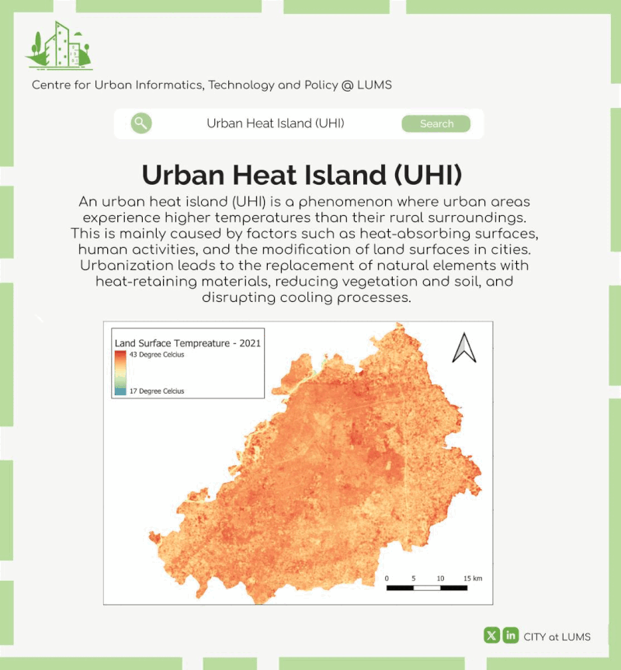
Abstract
Urban Heat Island (UHI) Monitor
A Python Application for Visualizing Temperature Patterns and Mitigation Strategies This Python application monitors Urban Heat Island (UHI) effects in cities. It retrieves five day weather forecasts, simulates urban and rural temperatures, and visualizes them using pie charts and real-time plots. Additionally, it displays the electromagnetic spectrum and suggests mitigation strategies based on the UHI intensity. The user-friendly interface allows entering city names and updating data.

Slide 11

Introduction
This Application!
Is Like A Weather Monitor For Cities, But For Heat! It Can Tell You How Hot A City Might Get By Looking At 5-day Forecasts. It Then Creates Charts To Show The Difference Between City Temperatures And Nearby Rural Areas. Based On This Difference, It Can Even Suggest Ways To Reduce The Heat In The City. Neat, Right?

Slide 12






or
Requirements

Slide 13

We Need Some Modules
Modules
Requests
Numpy
matplotlib.pyplot
matplotlib.backends.backend_tkagg
tkinter
PIL (Optional)

Slide 14
Requests
Modules
Requests
Used to make HTTP requests to the OpenWeatherMap API for fetching weather data.

Slide 15
Numpy
Modules
Numpy: Provides numerical computing capabilities for data manipulation and calculations.

Slide 16
matplotlib.pyplot
Modules
matplotlib.pyplot: Offers functions for creating various plots and visualizations.

Slide 17
matplotlib.backends.backend_tkagg
Modules
matplotlib.backends.backend_tkagg: Enables embedding matplotlib plots within Tkinter applications.

Slide 18
tkinter
Modules
tkinter: Provides the foundation for building graphical user interfaces (GUIs) in Python.

Slide 19
PIL
Modules
PIL (Optional): If the code is intended to work with image processing, the Pillow (PIL Fork) library might be necessary

Slide 20

Potential Applications
For future
Raising public awareness about UHI and its implications.
Serving as an educational tool for understanding urban climate science.
Assisting urban planners in developing UHI mitigation strategies and making informed decisions.
Conducting research on UHI patterns and their impacts.

Slide 21
Raising public awareness about UHI and its implications.
UHI Implications and Management Framework
The UHI effect occurs when urban areas are significantly warmer than surrounding rural regions. It’s a result of factors like fast urbanization and climate change.
Implications
Heat Risk: Urban areas, especially during heatwaves, face increased health risks due to extreme temperatures.
Air Pollution: UHIs worsen air pollution within cities.
Flood Risk: UHIs can impact rainfall patterns and increase flood risk.
Water Quality: Decreased water quality is another concern.

Slide 22
Serving as an educational tool for understanding urban climate science.
Fundamentals of Urban Climate Science: Introducing key concepts such as urban heat islands (UHI), microclimate dynamics, and the urban-rural temperature difference.
UHI Impacts on Society: Exploring how UHI affects human health, energy consumption, urban infrastructure, and the environment, emphasizing the importance of understanding these impacts for sustainable urban development.
Mitigation Strategies: Presenting various techniques and interventions to mitigate UHI effects, including green infrastructure, cool roofs, permeable surfaces, and urban planning measures aimed at enhancing urban climate resilience.
Interactive Learning Tools: Providing interactive simulations, case studies, and educational resources to engage learners and deepen their understanding of urban climate science and its relevance to everyday life and urban planning decisions.

Slide 23
Assisting urban planners in developing UHI mitigation strategies and making informed decisions.
Data-Driven Insights
Providing urban planners with access to real-time data on urban heat islands (UHI) to identify hotspots and prioritize areas for intervention.
Decision Support Tools
Offering tools and models to simulate the effectiveness of different mitigation strategies, aiding urban planners in selecting the most suitable interventions for their specific contexts.
Collaborative Platforms
Facilitating collaboration and knowledge-sharing among urban planners, researchers, and stakeholders to exchange best practices and collectively develop effective UHI mitigation strategies.

Slide 24
Conducting research on UHI patterns and their impacts.
Data Collection
Gathering temperature data from urban areas to identify UHI patterns and understand their spatial and temporal variations.
Impact Assessment
Analyzing the effects of UHI on local ecosystems, human health, energy consumption, and urban infrastructure to inform targeted mitigation strategies.

Slide 25

Future Work
Empower urban planning with real-time sensor data, comprehensive analysis, advanced visualizations, and predictive modeling for proactive UHI mitigation.

Slide 26
Real-time data integration
Explore incorporating real-time data from urban sensors for temperature and UV measurements to enhance the application's accuracy and responsiveness.

Slide 27
Comprehensive analysis
Consider including additional meteorological variables beyond temperature for a more holistic understanding of urban climate.

Slide 28
Advanced visualizations
Investigate advanced visualization techniques, such as geospatial mapping and animation, to better represent spatiotemporal patterns of UHI effects.

Slide 29
Predictive modeling
Explore the development of modules capable of predicting future UHI trends under different climate scenarios to support proactive mitigation planning.

Slide 30
Ethical Considerations
Transparency and Attribution: It's crucial to accurately attribute the OpenWeatherMap API as the source of weather data and provide clear documentation or references for any other borrowed resources or concepts.
Responsible Development: Consider the potential environmental and societal impacts of UHI and strive to contribute to solutions through this application's features and recommendations.
Avoidance of Misinformation: Ensure that the application accurately reflects established scientific principles and avoids presenting misleading or false information related to UHI or climate change.

Slide 31
A 5-day weather forecast
Real-time updates
How it Works - Beat the City Heat!
Pie chart visualizing
Urban Heat Island (UHI) effect
Urban and rural temperatures
OpenWeatherMap API
Work flow…
Leverage OpenWeatherMap API to retrieve 5-day weather forecasts for any city entered by the user.
Simulate urban and rural temperatures based on the forecast data, accounting for slight variations using random factors.
Calculate the Urban Heat Island (UHI) effect by subtracting the simulated rural temperature from the urban temperature.
Display the UHI effect prominently on the user interface, along with:
A clear pie chart visualizing the temperature difference between urban and rural areas.
Real-time updates for the electromagnetic spectrum and UV intensity. (Optional: Briefly mention these)
A 5-day weather forecast for the chosen city.
Recommend mitigation strategies based on the UHI intensity level, providing users with actionable ways to combat urban heat.
Notes:
No Slide Master
Double click to edit the bar

Slide 32

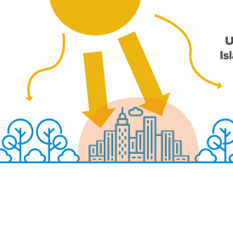
Lets find how it will works
To begin, ensure that the necessary required Modules are installed on your local machine(CMD). Once installed, execute the Python code within your preferred integrated development environment (IDE), such as IDLE for Python (3.10 or above), or any other suitable platform.

Slide 33
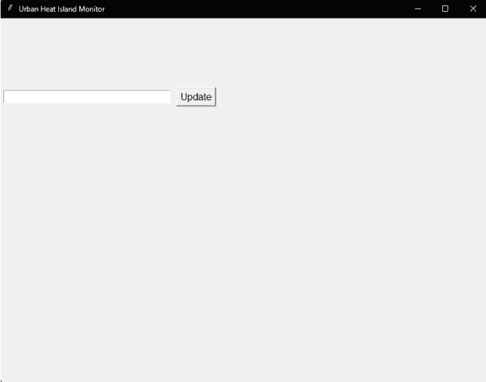
Step 1
After executing the Python code within IDLE for Python , we can utilize Tkinter to display a message box…

Slide 34
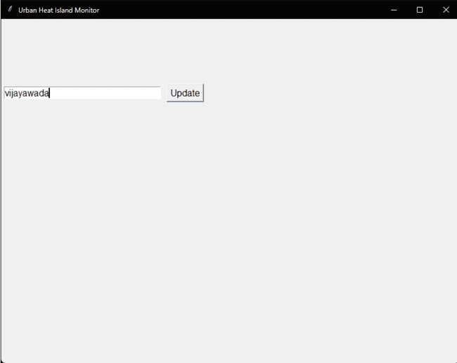
Step 2
To prompt the user to enter a city name for forecasting urban heat islands data, you can incorporate a simple input dialog using Tkinter

Slide 35
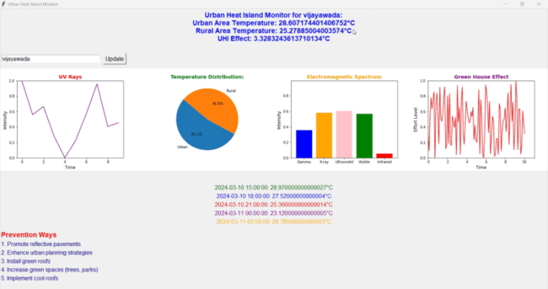

Step 3
Output

Slide 36
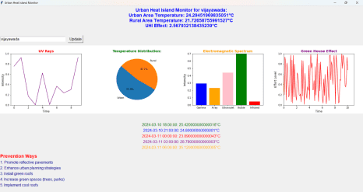
This Application Works on Any Platform

Slide 37

References…
OpenWeatherMap API: https://openweathermap.org/api
Tkinter Documentation: https://docs.python.org/3/library/tkinter.ht ml
Matplotlib Documentation: https://matplotlib.org/ (Consult the specific subpages for pyplot and backends)
(Optional) Pillow (PIL Fork) Documentation: https://pillow.readthedocs.io/en/stable/

Slide 38
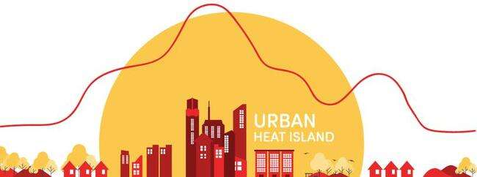
Thank You for Watching!

